Slide 1

Directorate of Technical Education Rajasthan, Jodhpur
Kaushal Darpan​
Version 1.0
User Manual for BTER Examination flow-
08-04-2025

Slide 2
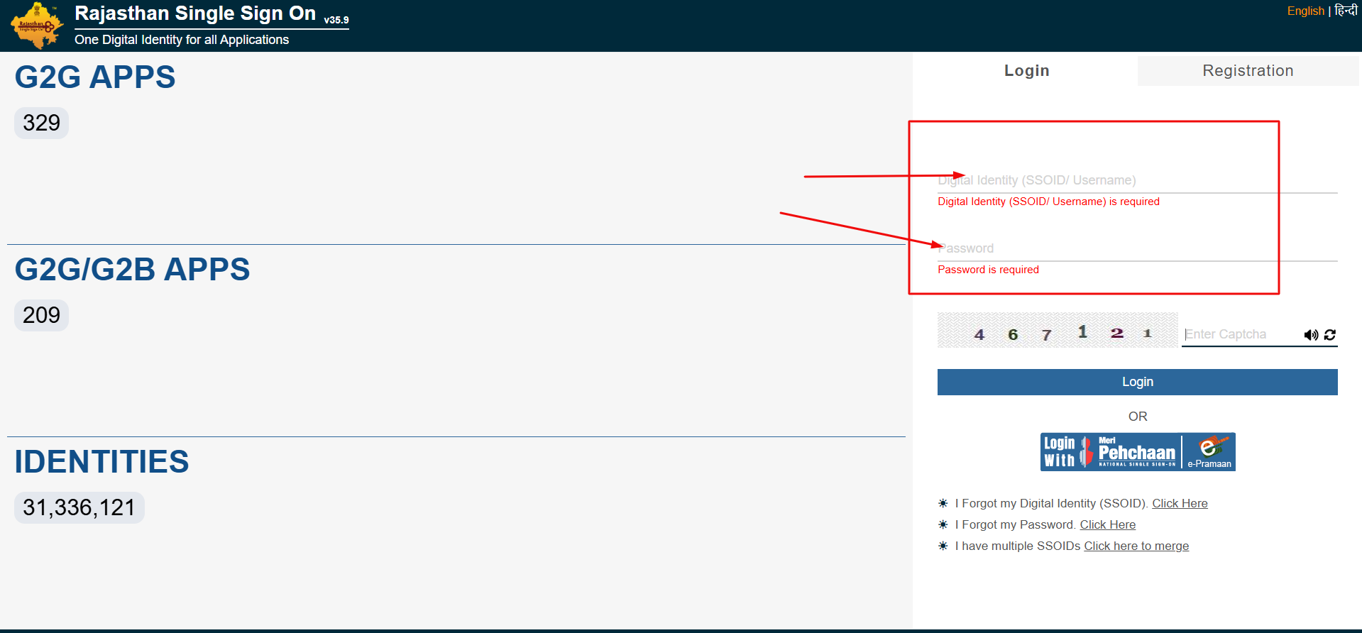
BTER Admin Login through SSO

Slide 3
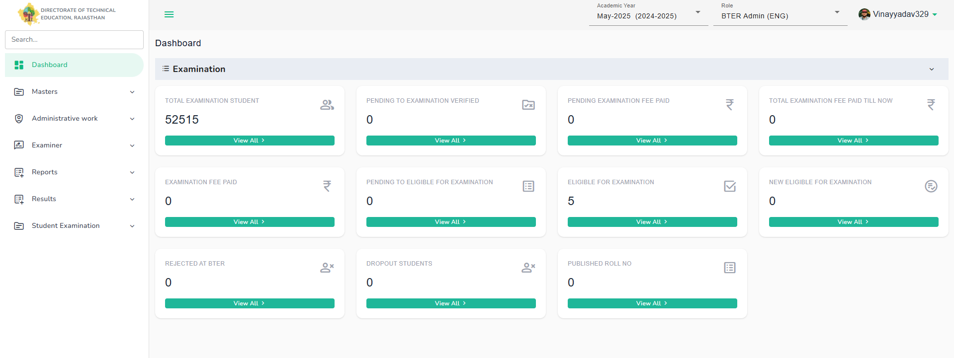
BTER Admin Dashboard will be open and admin can access the available menus of the system. Admin can view their data through dashboard and check the pendency status.

Slide 4
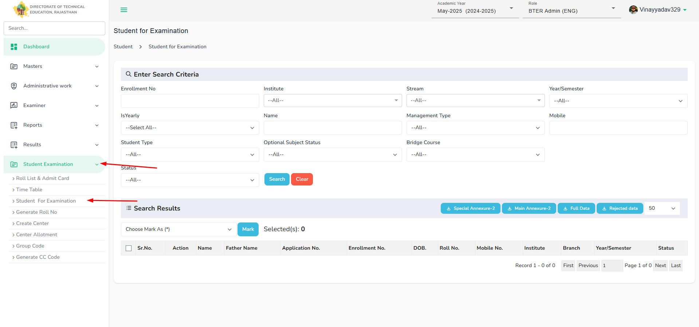
BTER Admin can view the list of students who are eligible for examination and mark them for further process.

Slide 5
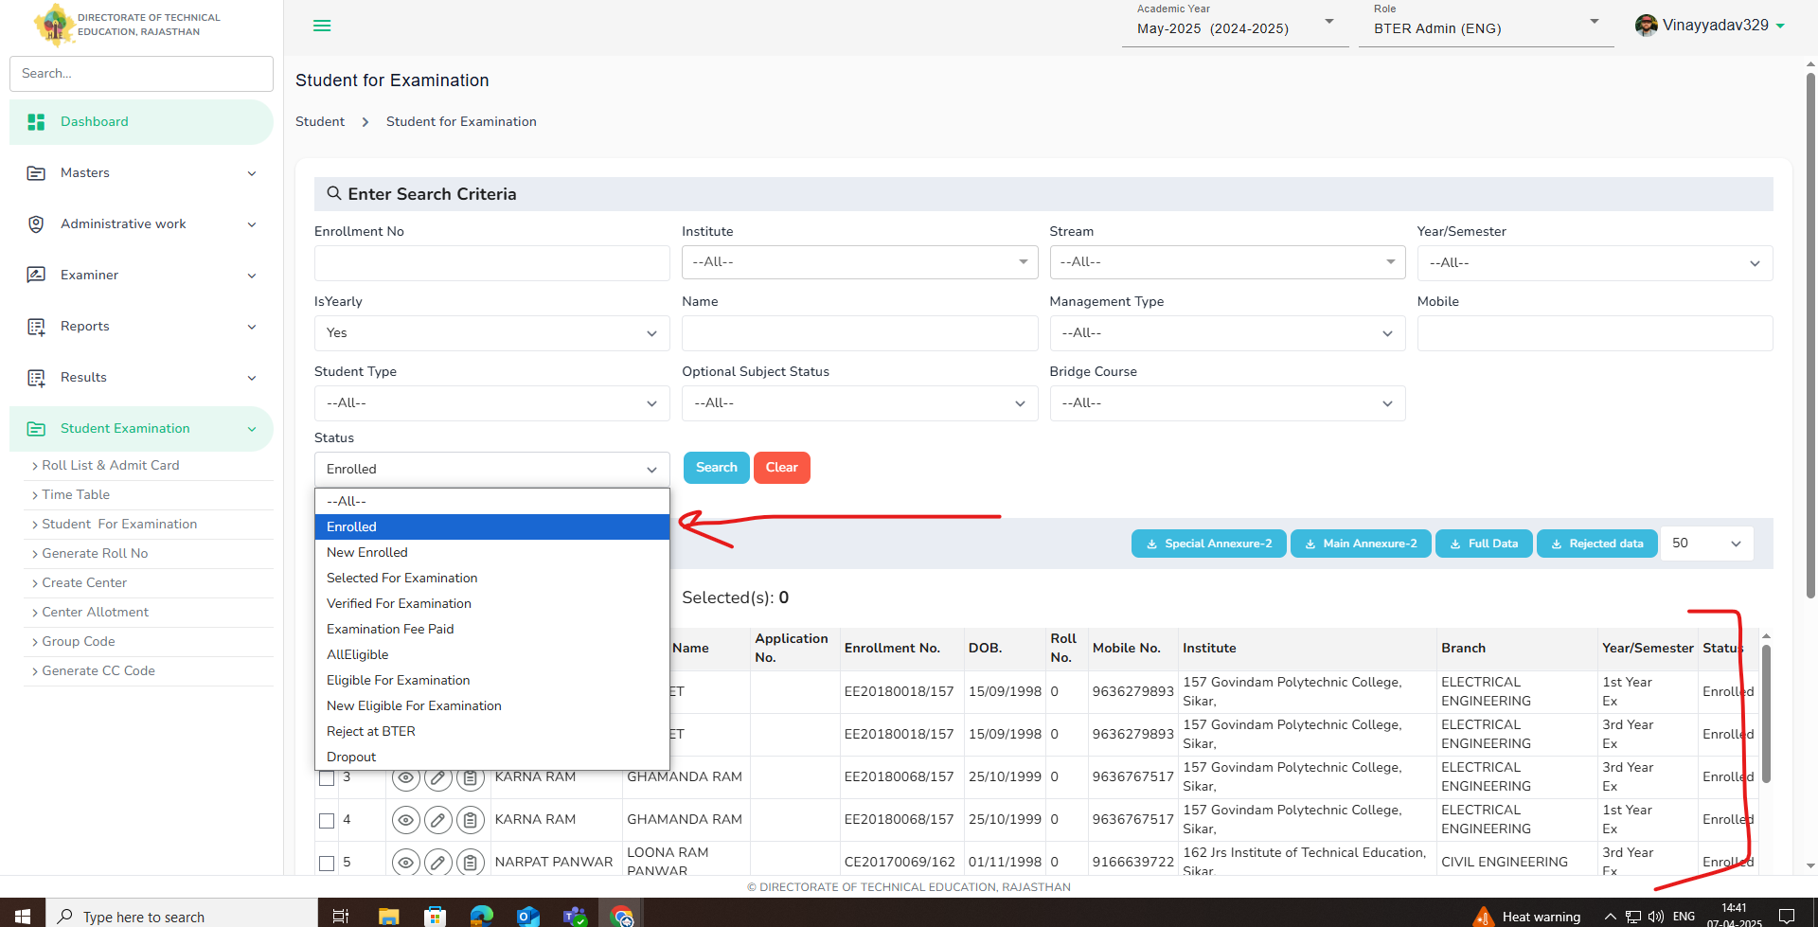
BTER Admin will select the student from list which are marked for " enrolled" and fill other relevant/required inputs and click on search. List of students will display.

Slide 6
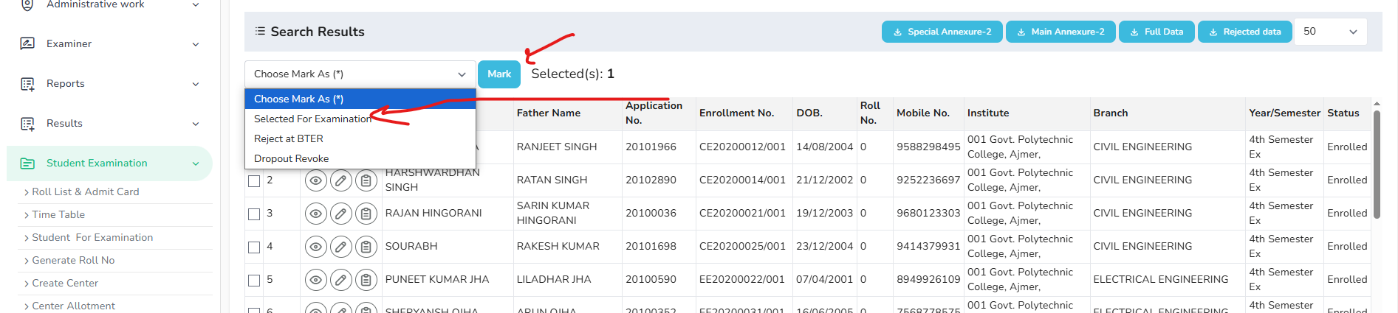
BTER Admin-> Select student -> select from list - "Selected for Examination" -> Click on mark. The student which have been marked for examination will process further for next process.

Slide 7
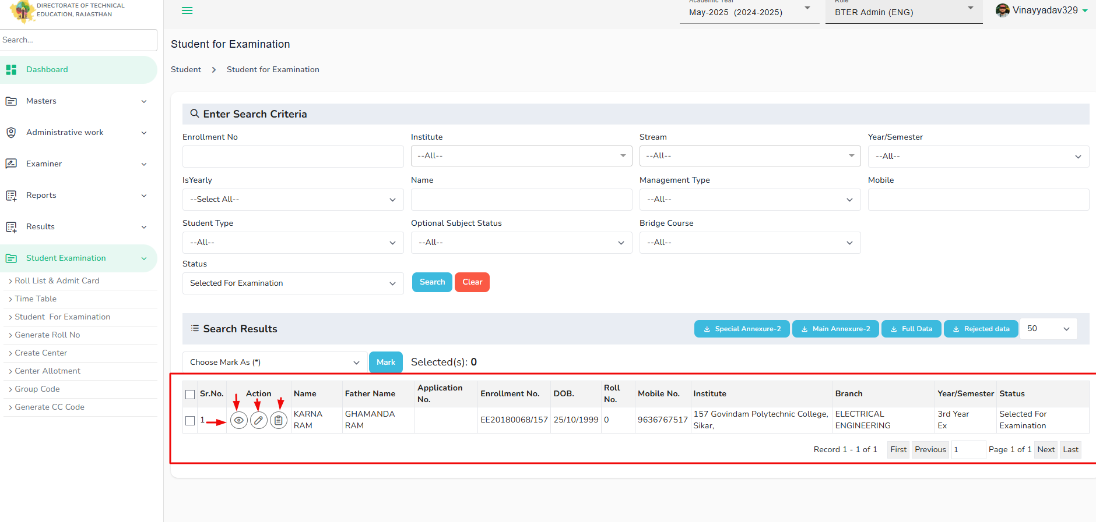
Student list will display and Admin have right to perform the action on student application ->
View student details 2. Edit student details 3. Edit enrollment details

Slide 8
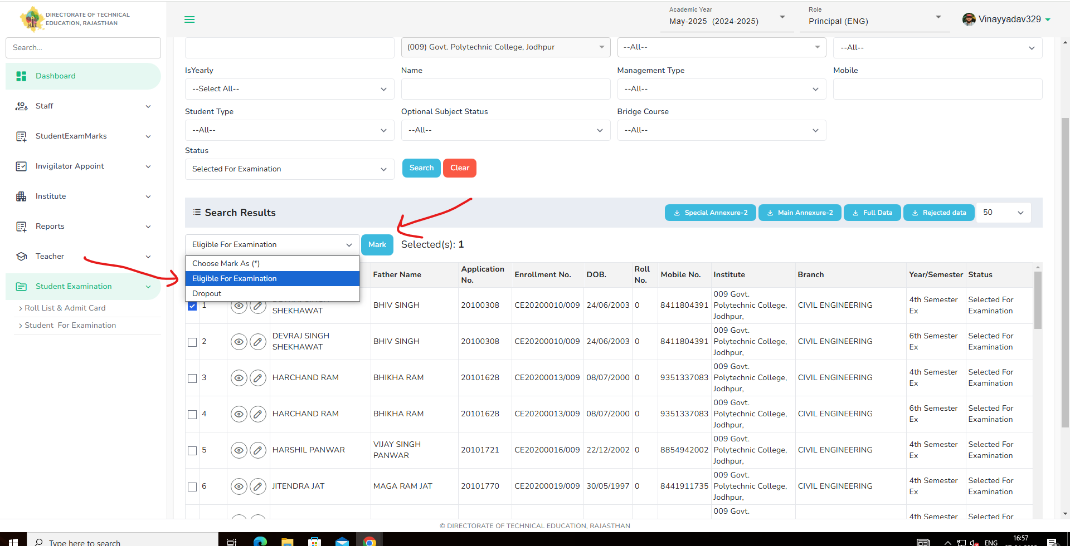
Principle login through sso -> dashboard-> open student examination tab-> Click student for examination. List of student selected for examination by BTER will display and principle can select the student and update the status -> "Eligible for examination" and click mark.

Slide 9
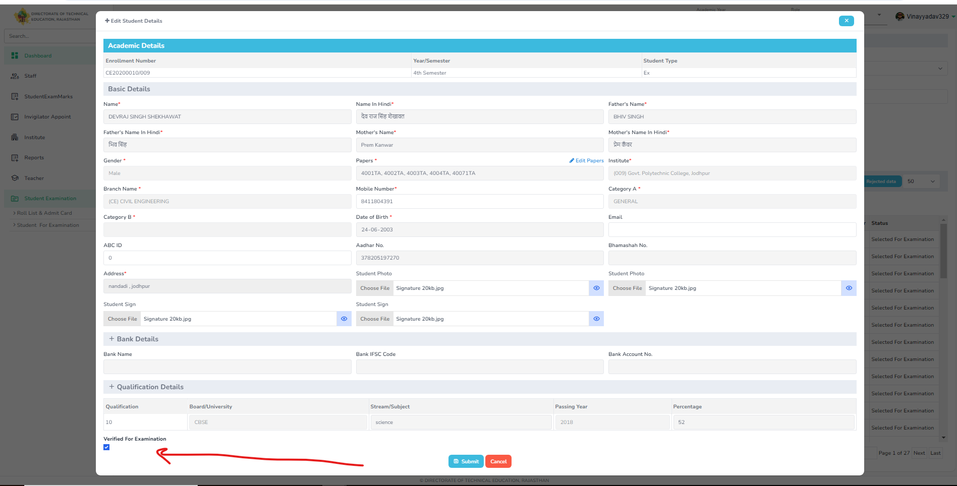
Principle will verify the student details and only after verifying the student details , student will be able to pay the fees.

Slide 10
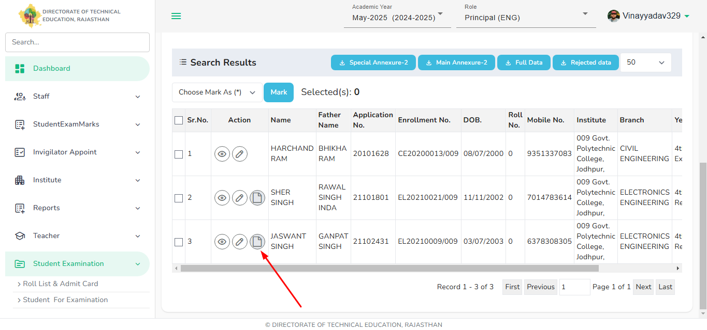
Principle can add optional subjects of the student only when the following conditions will be followed-
- -> Student will be from 4th semester and Regular-student.

Slide 11
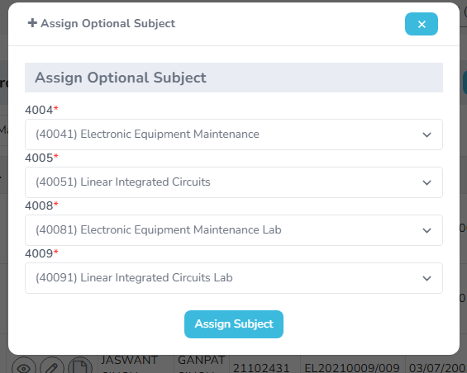
Screen for assigning optional subject for the student.

Slide 12
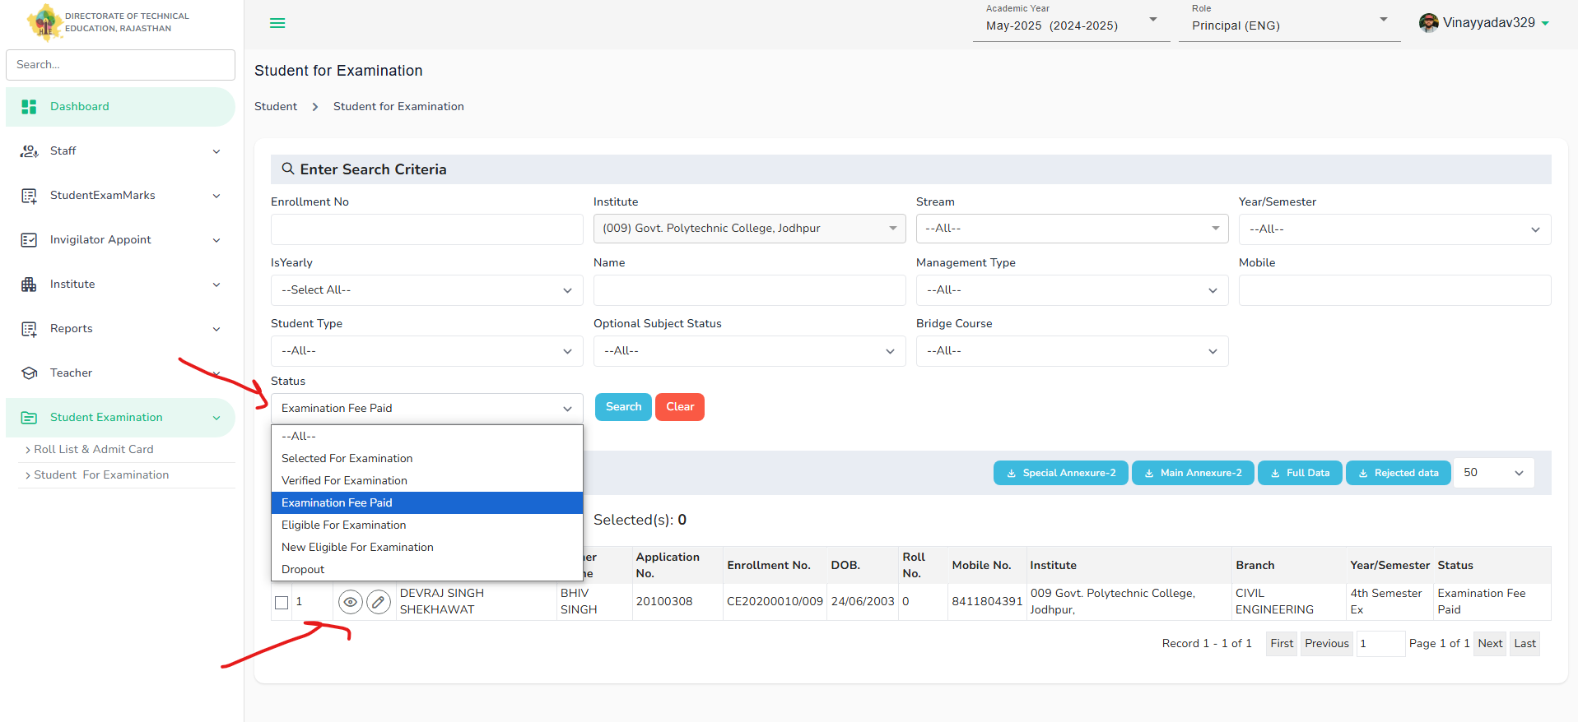
Principle can view the list of students who have paid the fees by updating the status – Examination fees paid, and list will open.

Slide 13
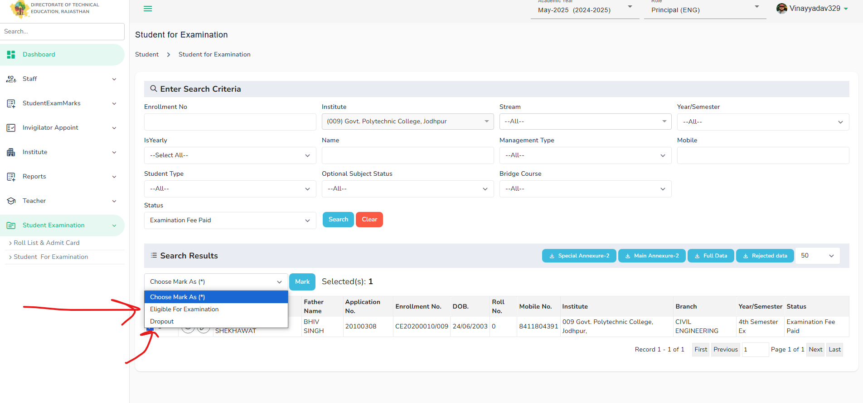
Principle will select the student and select the status -> Eligible for examination after verifying the fees and other details mentioned under the action column and click on mark.

Slide 14
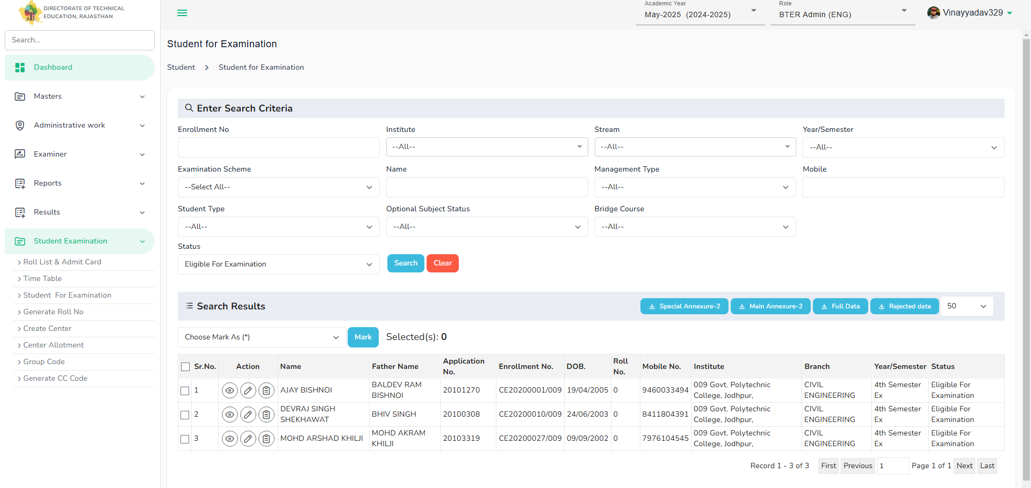
Details of students who are eligible for examination will display under the list which bter can principle both can view and proceed for further examination process.

Slide 15
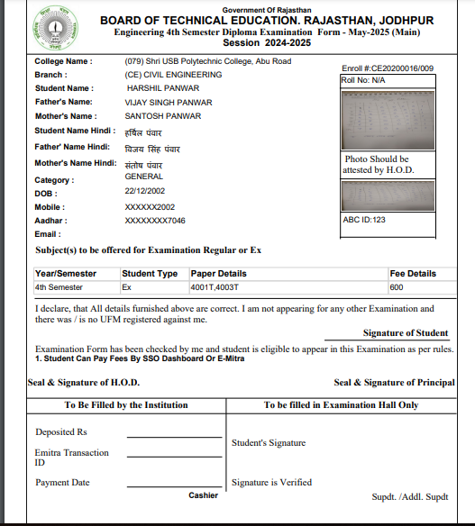
Examination form – BTER can download examination form under the status of " verified for examination" and under action column view and download the form.

